Slide 1
This conference is sponsored by
which supplies the Israeli military in surveilling, policing, and committing genocide on Palestinians
#NoConferenceAsUsual
Notes:
INSERT COMPANY FROM TOOLKIT

Slide 2

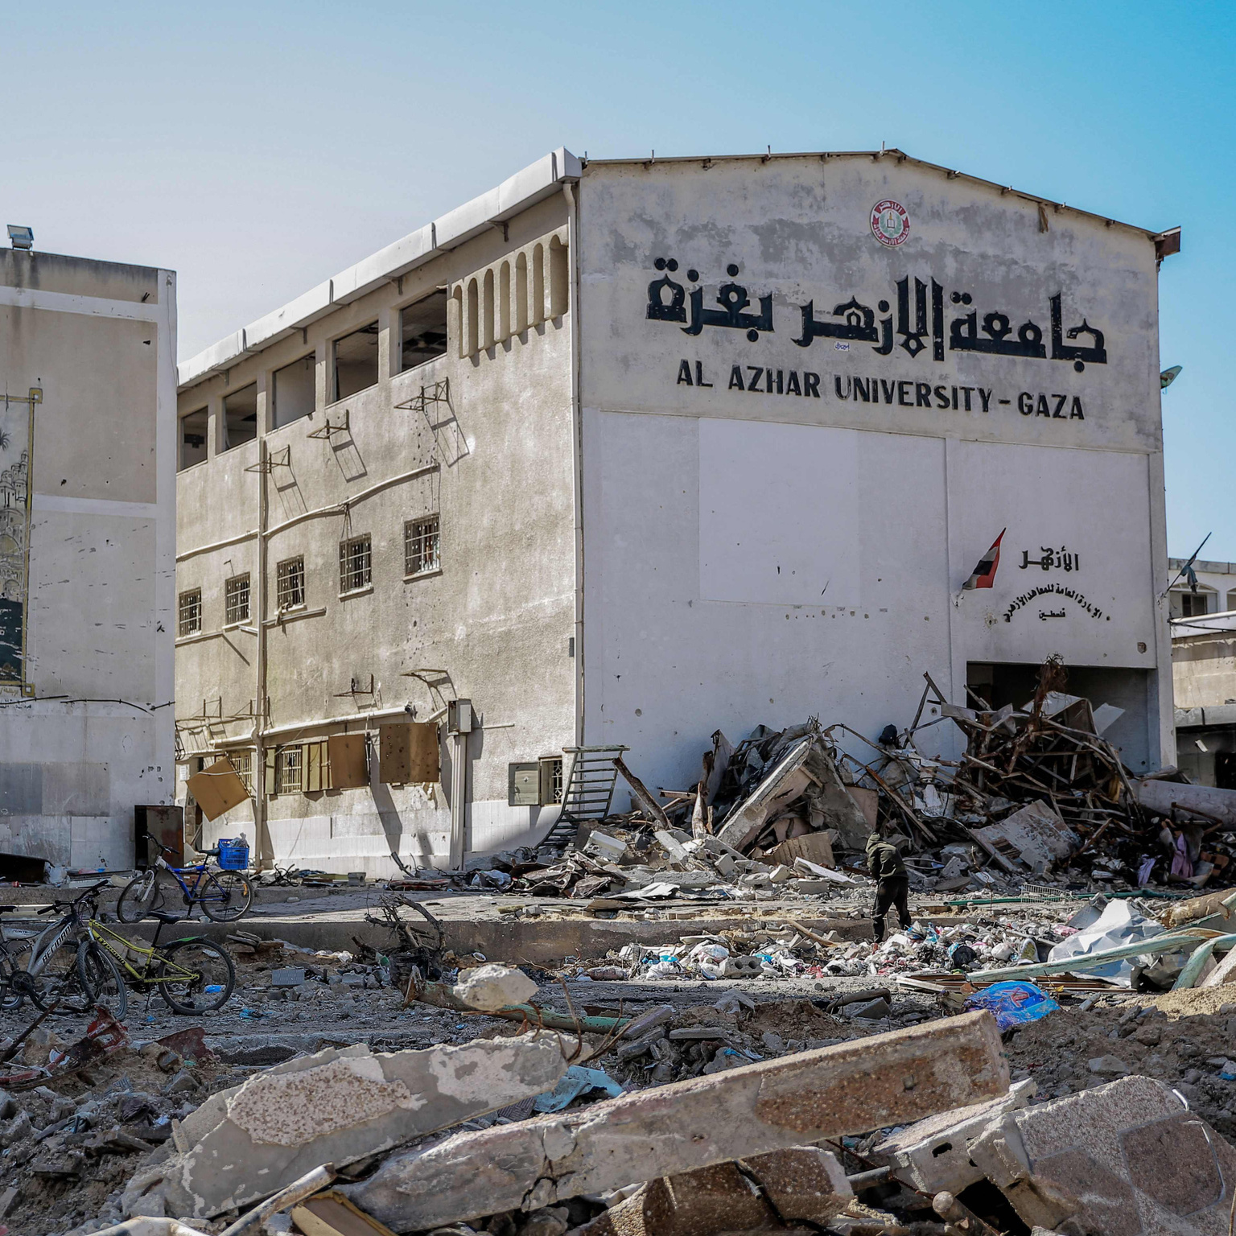
#NoConferenceAsUsual
No universities are left in Gaza

Slide 3

But students and university boards are still alive and trying to restore education!
You can support an eSIM for a student so they can continue their studies online. Scan the QR code for a how-to on this initiative and how you can help.
tinyurl.com/gaza-esims
when you donate your eSIM, put “student” in the subject line
#NoConferenceAsUsual
Notes:
Two-parter with previous slide

Slide 4
Did you know?
6 Mars rovers have been built, assembled, and/or operated by 12 companies that supply the Israeli military in surveilling, policing, and committing genocide on Palestinians
#NoConferenceAsUsual
Notes:
Mars surface

Slide 5
Did you know?
8 companies that have built, assembled and/or operated Mars orbital missions also supply the Israeli military in surveilling, policing, and committing genocide on Palestinians, including with the illegal chemical weapon white phosphorus
#NoConferenceAsUsual
Notes:
Mars orbital

Slide 6
Did you know?
7 companies that have built, assembled, and/or operated lunar orbital missions also supply the Israeli military in surveilling, policing, and committing genocide on Palestinians
#NoConferenceAsUsual
Notes:
Lunar

Slide 7
Did you know?
10 companies that support the Artemis program also supply the Israeli military in surveilling, policing, and committing genocide on Palestinians
#NoConferenceAsUsual
Notes:
Lunar

Slide 8
Did you know?
7 companies that build, launch, and/or operate space telescopes, including Hubble, JWST, and Roman, also supply the Israeli military in surveilling, policing, and committing genocide on Palestinians
#NoConferenceAsUsual
Notes:
Planetary / astronomy

Slide 9
Did you know?
MESSENGER and BepiColumbo have been built, launched, and/or operated by 3 companies that supply the Israeli military in surveilling, policing, and committing genocide on Palestinians
#NoConferenceAsUsual
Notes:
Mercury

Slide 10
Did you know?
the building, launch, and operation of Europa Clipper incorporates 6 companies that supply the Israeli military in surveilling, policing, and committing genocide on Palestinians
#NoConferenceAsUsual
Notes:
Europa

Slide 11
Did you know?
all 8 outer solar system missions have been built, assembled, and/or operated by 10 companies that supply the Israeli military in surveilling, policing, and committing genocide on Palestinians
#NoConferenceAsUsual
Notes:
Outer solar system

